Slide 1
Standard Access Control Model
Overview
RBAC
ARBAC97
Role Mining
TRBAC
ESTRBAC
ABAC

Slide 2
Overview
Role Based Access Control (RBAC)
ARBAC97
  An administrative model to manage RBAC
  Fine Grained Access Control:
Temporal-Role Based Access Control (TRBAC)
Spatio-Temporal Role Based Access Control (STRBAC)
Role Mining
Mining roles from the access control matrix.

Slide 3
RBAC
Access depends on functionality, not identity.
  Example:
    Allison, bookkeeper for Math Dept., has access to financial records.
    She leaves.
    Betty hired as the new bookkeeper, so she now has access to those records.
  The role of “bookkeeper” dictates access, not the identity of the individual.

Slide 4
RBAC Terms and Concepts
Access
  A specific type of interaction between a subject and an object that results in the flow of information from one to the other.
Access Control
  The process of limiting access to the resources of a system only to authorized programs, processes, or other systems.

Slide 5
Cont..
Administrative Role
  Includes permission to modify the set of users, roles, or permissions, or to modify user assignment and permissions assignment relations.
Constraint
  A relationship between or among roles.
Group
  A set of users.

Slide 6
Cont..
Object
  A passive entity that contains or receives information.
Permissions
  A description of the type of authorized interactions a subject can have with an object.
Resource
  Anything used or consumed while performing a function e.g., time, objects processors, etc.

Slide 7
Cont..
Role
  A job function within the organization that describes the authority and responsibility conferred on a user assigned to the role.
Role Hierarchy
  A partial order relationship established among roles.
Session
  A mapping between a user and an activated subset of the set of roles the user is assigned to.

Slide 8
Cont..
Subject
  An active entity e.g. person, process, or device that causes information to flow among objects or changes the system state.
System Administrator
  The individual who establishes the system security policies, performs the administrative roles, and reviews the system audit trail.

Slide 9
Cont..
User
  Any person who interacts directly with a computer system.

Slide 10
Security Principles
Although the RBAC concept is policy neutral, it directly supports three well-known principles:
  Least Privilege: Only those permissions required to perform the tasks are assigned to the role.
  Separation of Duty: Invocation of mutually exclusive roles can be required to complete a sensitive task.
  Data Abstraction: Instead of read, write, etc., permissions, abstract permissions e.g. credit and debit for an account, can be established.

Slide 11
A Family of RBAC
RBAC₃: Role Hierarchies
+ Constraints
RBAC₁: Role Hierarchies
RBAC₂:
Constraints
RBAC₀: BASIC RBAC

Slide 12
RBAC₀
User Assignment
(UA)
Permission Assignment (PA)
Users
(U)
Roles
(R)
*
Permissions
(P)
*
*
*
*
1
*
*
Sessions
(S)

Slide 13
RBAC₀
Four entities:
  Users (U)
  Roles (R)
  Permissions (P)
  Sessions (S)
    Users establish sessions during which they may activate a subset of the roles they belong to.
Note: A user might have different sessions open simultaneously, each in a different window on a workstation screen.

Slide 14
Formal definition of RBAC₀
It has the following components:
  U, R, P, and S represent a set of users, roles, permissions, and sessions ,respectively.
  PA ⊆ P×R, a many to many permission to role assignment relation.
  UA ⊆ U×R, a many to many user to role assignment relation.
  user: S→U, a function mapping each session s_{i} to the single user user(s_{i}).

Slide 15
Cont..
  roles: S→2^{R}, a function mapping each session s_{i} to a set of roles (s_{i}) ⊆ { r | (user (s_{i}),r) ∈ UA} and session s_{i} has the permissions U _{r ∈ roles(si)} {(p, r) ∈ PA}.
Fewer relationships to manage
  From O(mn) to O(m+n), where m is the number of users and n is the number of permissions.

Slide 16
RBAC₁: RBAC₀+ Role
Hierarchy
Role Hierarchy (RH)
User Assignment
(UA)
Permission Assignment (PA)
Users
(U)
Roles
(R)
*
Permissions
(P)
*
*
*
*
1
*
*
Sessions
(S)

Slide 17
RBAC₁
U, R, P, S, PA, and UA are unchanged from RBAC₀.
RH ⊆ R×R is a partial order on R called the role hierarchy or role dominance relation, also written as ≥.
  roles: S→2^{R} is modified from RBAC₀to require roles (s_{i}) ⊆ { r | (∃r’≥ r) [ (user (s_{i}), r’) ∈ UA]) and session s_{i} has the permissions U _{r ∈ roles(si)} {p | (∃r’’≤ r) [(p, r’’) ∈ PA]}.
Partial order on R:
Reflexive: r1 ≥ r1. (Inheritance is reflexive because a role inherits its own permissions)
Antisymmetric: If r1≥r2 and r2≥r1, then r1=r2 (two distinct roles cannot be inherited in both directions)
Transitive: If r1 ≥ r2 and r2 ≥ r3, then r1 ≥ r3

Slide 18
RBAC₁:Example
Primary-Care Physician
Specialist Physician
Physician
Health-Care Provider

Slide 19
Semantics of Role Hierarchies
User inheritance
  r1≥r2 means every user that is a member of r1 is also a member of r2
Permission inheritance
  r1≥r2 means every permission that is authorized for r2 is also authorized r1
Activation inheritance
  r1≥r2 means that activating r1 will also activate r2

Slide 20
RBAC₁
Test Engineer’
Team Leader
Programmer’
Test Engineer
Programmer
Project member
Limited Inheritance

Slide 21
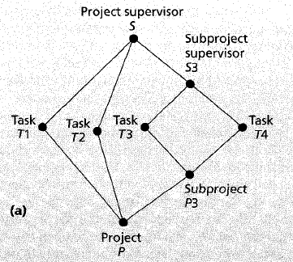
RBAC₁: Private Sub-hierarchy

Slide 22
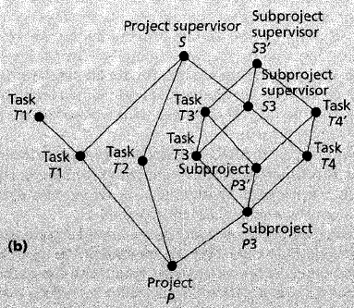
RBAC₁: Private Sub-hierarchy

Slide 23
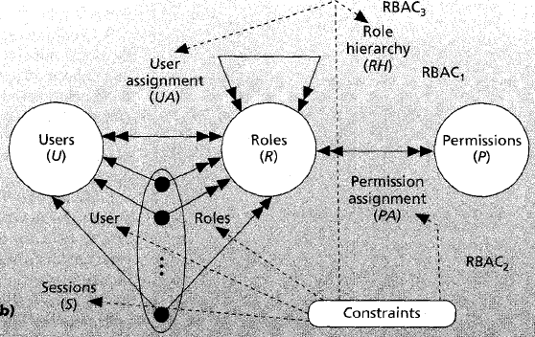
RBAC₂ : Constraints

Slide 24
RBAC₂ : Constraints
Mutually Exclusive Roles
Cardinality
Prerequisite Roles

Slide 25
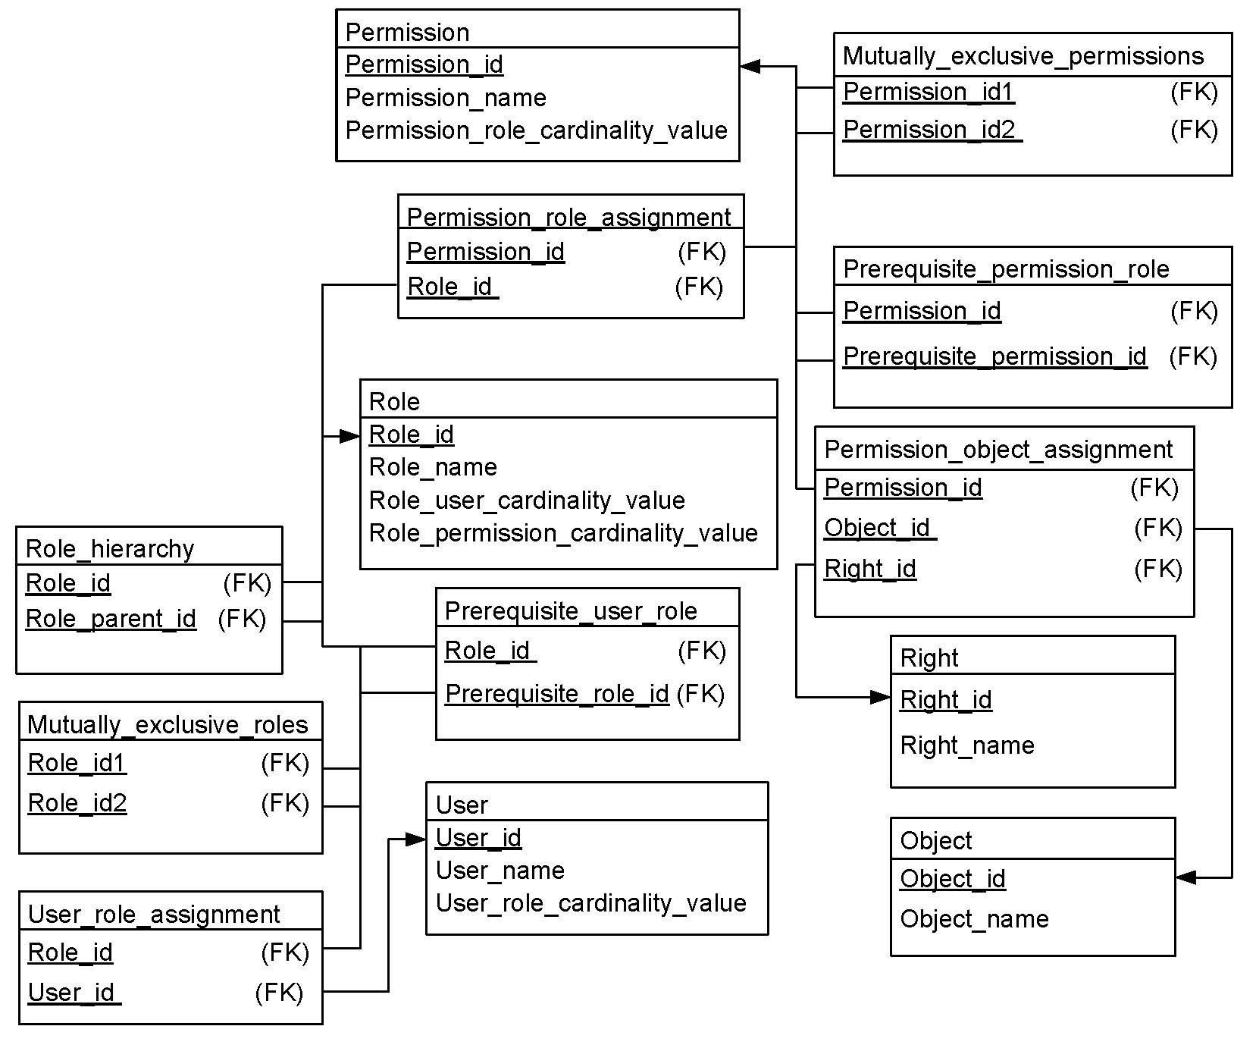
Database Schema

Slide 26
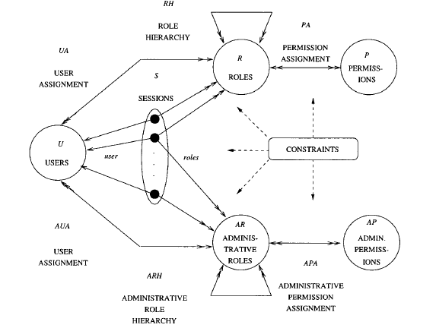
ARBAC97

Slide 27
ARBAC97
U, a set of users.
R and AR, disjoint sets of roles and administrative roles.
P and AP, disjoint sets of permissions and administrative permissions.
S, a set of sessions.
UA ⊆ U×R, user to role assignment relation.
AUA ⊆ U×AR, user to administrative role assignment relation.
PA ⊆ P×R, permission to role assignment.

Slide 28
ARBAC97
APA ⊆ AP×AR, permission to administrative role assignment.
RH ⊆ R×R, partially ordered role hierarchy.
ARH ⊆ AR×AR, partially ordered administrative role hierarchy.
user: S→U, maps each session to a single user.
  roles: S→2^{R} , maps each session to a set of roles (s_{i}) ⊆ { r | (∃r’≥ r) [ (user(s_{i}), r’) ∈ UA ∪ AUA]) and session s_{i} has permissions U _{r ∈ roles(si)} {p | (∃r’’≤ r) [(p, r’’) ∈ PA ∪ APA]}.

Slide 29
ARBAC97
It has three components:
  URA97 (user-role assignment)
  can_assign ⊆ AR × CR × 2^{R}
  can_revoke ⊆ AR × 2^{R}
  PRA97 (permission-role assignment)
  can_assignp ⊆ AR × CR × 2^{R}
  can_revokep ⊆ AR × 2^{R}
  RRA97 (role-role assignment)

Slide 30
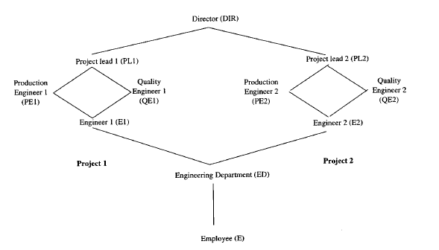
Example: Role Hierarchy

Slide 31
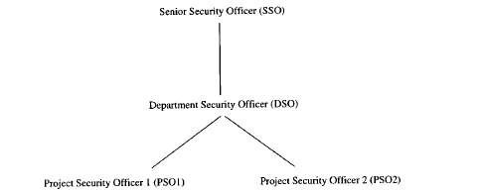
Example: Administrative Hierarchy

Slide 32
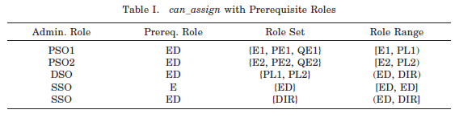

URA97

Slide 33

URA97
Role sets are specified in the URA97 using below given notation:

Slide 34
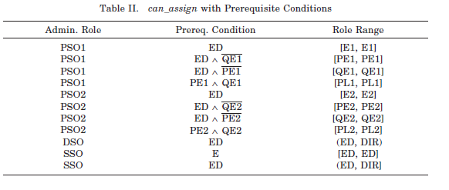
URA97

Slide 35
URA97
can_revoke ⊆ AR × 2^{R}
It is a weak revocation operations because it applies only to the role that is directly revoked.
Let us say a user U is an explicit member of role x if (U, x) Ɛ UA, and that U is an implicit member of role x if for some x’> x, (U, x’) Ɛ UA.
Strong revocation is theoretically equivalent to a series of weak revocation.
URA97 does not deal with creation or deletion of users.

Slide 36
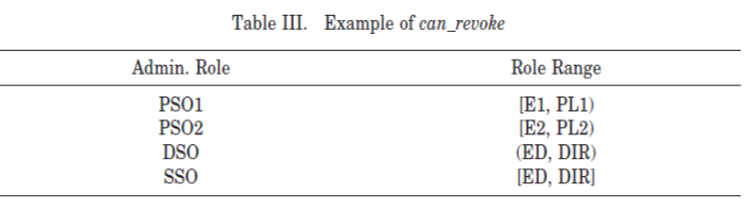
URA97
Let Alice is a member PSO1 role.

Slide 37
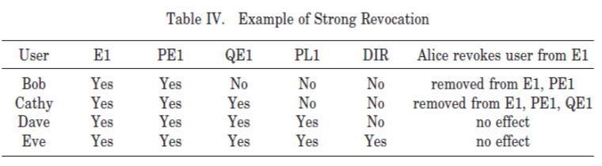
URA97
Weak Revocation
Strong Revocation:
Find all roles y≥x such that a user is an explicit member of y. Weakly revoke a user from all such y. If any of the weak revocations fails, then strong revocation has no effect.

Slide 38
PRA97
can_assignp ⊆ AR × CR × 2^{R}
can_revokep ⊆ AR × 2^{R}
Revocation in PRA97 is weak, so permissions may still be inherited after revocation.
Let us say a permission P is explicitly assigned to role x if (P, x) Ɛ PA, and that P is implicitly assigned to role x if for some x’< x, (P, x’) Ɛ PA.

Slide 39
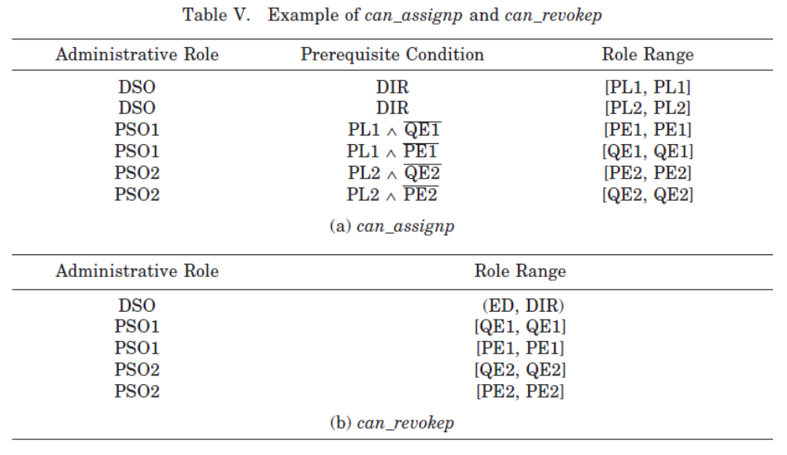
PRA97

Slide 40
RRA97
For role-role assignment, we distinguish three kinds of roles, as follows:
Abilities: are roles that can only have permissions and other abilities as members.
Groups: are roles that can only have users and other groups as members.
UP-Roles: are roles that have no restriction on membership, i.e., their membership can include users, permissions, groups, abilities, and other UP-roles.

Slide 41
RRA97
The three kinds of roles are mutually disjoint and are identified, respectively, as A, G, and UPR.
An ability is a collection of permissions that should be assigned as a single unit to a role.
For example, the ability to open an account in a banking
application.
The function of an ability is to collect permissions together so that administrators can treat them as a single unit.
Assigning abilities to roles is therefore very much like assigning permissions to roles.

Slide 42
RRA97
Abilities can be organized into a hierarchy.
Ability-role assignment and revocation
can_assigna ⊆ AR × CR × 2^{A}
can_revokea ⊆ AR × 2^{A}
A group is a collection of users who are assigned as a single unit to a role.
A group can be organized into a hierarchy.
Group-role assignment and revocation
can_assigng ⊆ AR × CR × 2^{G}
can_revokeg ⊆ AR × 2^{G}

Slide 43
RRA97
For these models, CR is interpreted as the collection of prerequisite conditions formed using roles in UPR.
The prerequisite conditions are interpreted with respect to abilities and groups, respectively.
In RRA97 role creation, role deletion, edge insertion, and edge deletion are all authorized by the following relation.
can_modify ⊆ AR × 2^{R}

Slide 44
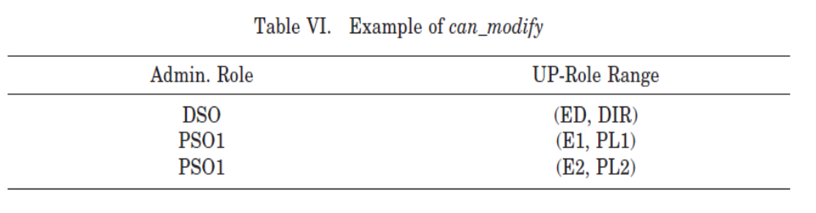
RRA97
Decentralization of administrative authority requires that members of different administrative roles have authority over different parts of the hierarchy.
It implies autonomy in modifying the internal role structure of that part.

Slide 45
RRA97
In particular, none of these operations is allowed to introduce a cycle in the hierarchy.
Creation of a new role requires the specification of its immediate parent and child in the existing hierarchy.
Generally, the immediate parent and immediate child must fall within the range or be one of the endpoints as specified in can_modify.
Since creation of a role also introduces two edges in the hierarchy, it is not possible to use any two roles as the immediate parent and immediate child.

Slide 46
RRA97
Deletion of a role leaves relationships between the parents and children of the deleted role unchanged.
Our approach is to prohibit deletion that would cause a dangling reference.
Roles that cannot be deleted due to this reason can be deactivated, so that they can be phased out later by adjusting the references that prevent deletion.
Insertion of an edge is meaningful only between incomparable nodes.
Likewise, deletion of an edge is meaningful only if that edge is not transitively implied by other edges.

Slide 47
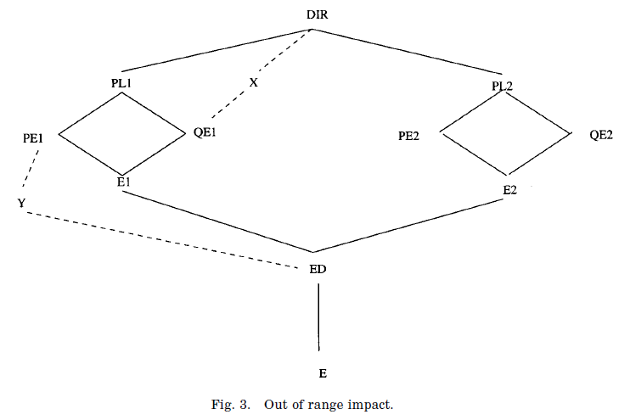
Restrictions on can_modify
It confers authority to administrative roles to change the role hierarchy.
We would like to restrict this authority to maintain global consistency of authorization.

Slide 48
Cont..
We should either restrict the authority of the administrative role (in our example DSO) that introduced X and Y roles in the first place.
or PSO1 should be prevented from introducing relationships that make PE1 junior to QE1 (and indirectly Y junior to X).
To formally state these restrictions on the authority of the administrative roles, we introduce the concepts of authority range, encapsulated authority range, and create range.

Slide 49
Cont..
Range:
Definition. A range of roles is defined by giving lower bound x and upper bound y, where y > x. Formally, (x, y) = { z : R| x < z > y}. We say x and y are the end points of the range.
Example:
Three ranges: (E1, PL1), (E2, PL2), and (ED, DIR)
The range (ED, DIR) contains roles that constitue ranges (E1, PL1) and (E2, PL2).
(E1, PL1) and (E2, PL2) are junior to (ED, DIR).

Slide 50
Cont..
Definition. For two ranges Y and Y’ if Y ⊂ Y’, then Y is a junior range to Y’, and Y’ is a senior range to Y.
If two ranges Y and Y ’ in the role hierarchy are such that one is not junior to the other, then they are either incomparable or partially overlapping.
Definition. Ranges Y and Y’ partially overlap if Y ∩ Y’ ≠ Φ and Y ⊄ Y’ and Y’ ⊄ Y. Ranges Y1 and Y2 are said to be incomparable if Y1 ∩ Y2 =Φ.
Note that incomparable ranges may have one common end point.

Slide 51
Authority Range and Encapsulated Authority Range
Definition. Any range referenced in the can_modify relation is called an authority range.
Definition. In RRA97, authority ranges do not partially overlap.
The model allows an administrative role to have authority over more than one incomparable authority range.
To maintain consistency, the concept of encapsulation of authority range is proposed.
Definition. A range (x, y) is said to be encapsulated if ∀ r1 ∈ (x, y) ˄∀ r2 ∉(x, y); we have r2 > r1 ⇔ r2 > y and r2 < r1 ⇔ r2 < x.

Slide 52
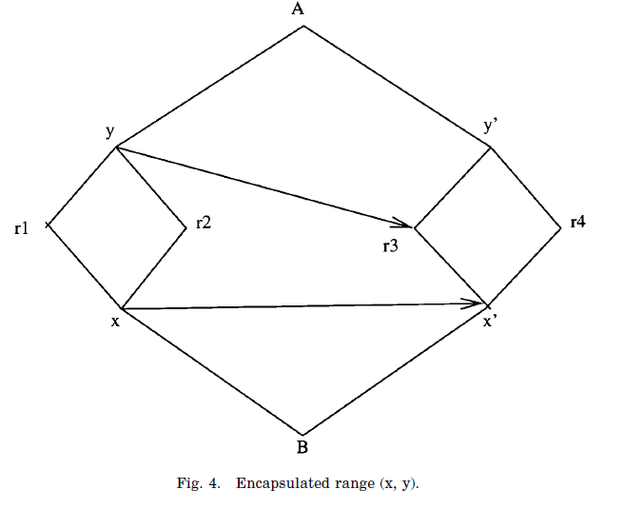
Example

Slide 53
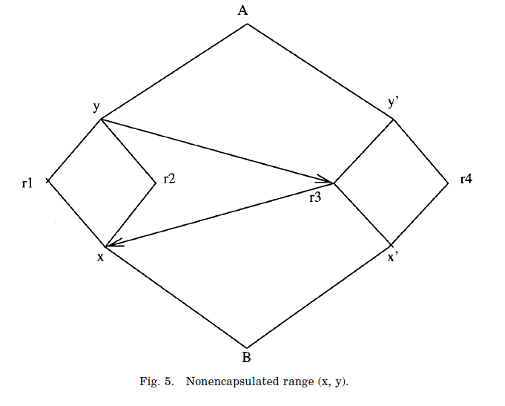
Example

Slide 54
Cont..
Intuitively, an encapsulated range is one in which all roles have identical relations to roles outside of the range.
The intuition in RRA97 is that an encapsulated range is the correct unit for autonomous management of role-role relationships within the range.
All authority ranges in RRA97 are required to be encapsulated.

Slide 55
Role Creation
The creation of a role requires specification of the new role’s immediate parent and child.
If the immediate parent and child are the end points of an authority range, there is no difficulty.
More generally, we wish to allow creation of a new role such that its immediate parent and child are within the authority range, rather than being at the end points.
Thus PSO1 can create a new role with parent PL1 and child PE1. However, if DSO exercises this power, we can end up with the undesirable situation.

Slide 56
Cont..
To prevent this, we introduce the following notions.
Definition. The immediate authority range of role r written
Ar_{immediate} (r) is the authority range (x, y) such that r ∈ (x, y), and for all authority ranges (x’, y’) junior to (x, y), we have r ∉ (x’, y’).
Definition. The range (x, y) is a create range if Ar_{immediate} (x) = Ar_{immediate}(y), or x is an end point of Ar_{immediate}(y), or y is an end point of Ar_{immediate} (x).
Note that only comparable roles constitute a create-range.

Slide 57
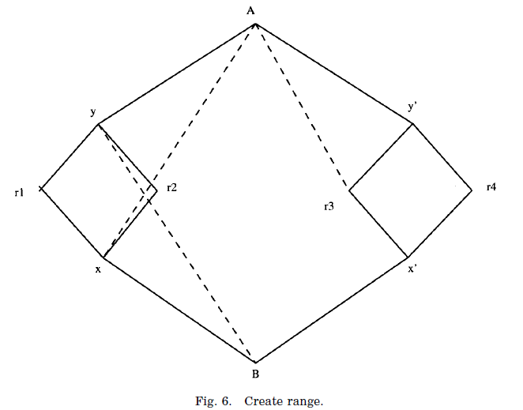
Cont..

Slide 58
Cont..
Authority ranges: (B, A) and (x, y) but not (x’, y’)
Create ranges: (r3, A), (x, A) and (B, y) but not (r1, A) or (r2, A)
In RRA97, it is required that the immediate parent and child of a new role must be a create range in the hierarchy prior to creation of the new role.
In RRA97, the immediate parent and immediate child of a new role must constitute a create range prior to creation of the new role.

Slide 59
Role deletion
It is assumed that a role in an authority range can be deleted by the administrator of that range. It does not matter how this role got there.
RRA97 provides two alternatives.
(1) Roles referred in can_assign, can_revoke, and can_modify relationships cannot be deleted.
(2) Roles referred in 1 above can be made inactive (explained in the next paragraph) whenever deleting them is needed.
The advantage of deactivating roles is that reference to
non-existing roles is avoided, and at the same time the purpose of deletion is achieved.

Slide 60
Cont..
In case of deletion of a role, we need to preserve the permissions and users assigned to the role. RRA97 provides two alternatives to deletion of roles.
(1) Roles can be deleted only if they are empty.
(2) Delete a nonempty role, but at the same time take care of the assigned permissions and associated users, as follows: assign permissions to the immediate senior roles and assign users to immediate junior roles.

Slide 61
Edge Insertion
When an edge is inserted, we must ensure that encapsulation of authority range is not violated. We have the following rules.
The roles, between which the edge is inserted, must have same immediate authority range; or
If the new edge connects a role in one authority range to a role outside the range, encapsulation of the authority range must not be violated.

Slide 62
Cont..
For example, in Figure 5 assume edges (y, r3) and (r3, x) are initially not present and that (x, y) and (B, A) are authority ranges.
Insertion of the edge (y, r3) does not pose any problem. However, in presence of this edge, insertion of edge (r3, x) violates encapsulation of authority range (x, y), hence it must not be allowed.
Similarly, in the presence of (r3, x), the edge (y, r3) is not allowed.

Slide 63
Cont..
This leads to the following formal definition for insertion of an edge.
Definition. A new edge AB can be inserted between incomparable roles A and B
If Ar_{immediate}(A) = Ar_{immediate}(B), or
If (x, y) is an authority range such that (A = y ˄ B > x) ˅ (B = x ˄ A < y), then insertion of AB must preserve encapsulation of (x, y).

Slide 64
Edge deletion
Deletion of transitive edges does not change the hierarchy, so their deletion is meaningless.
In RRA97, we consider only those edges for deletion that are in transitive reduction of the hierarchy.
There is one special case that needs to be considered.
If the edge being deleted is between the end points of an authority range, deletion of the edge will disrupt the authority range and cause inconsistency in the model.
Hence this operation is disallowed.

Slide 65
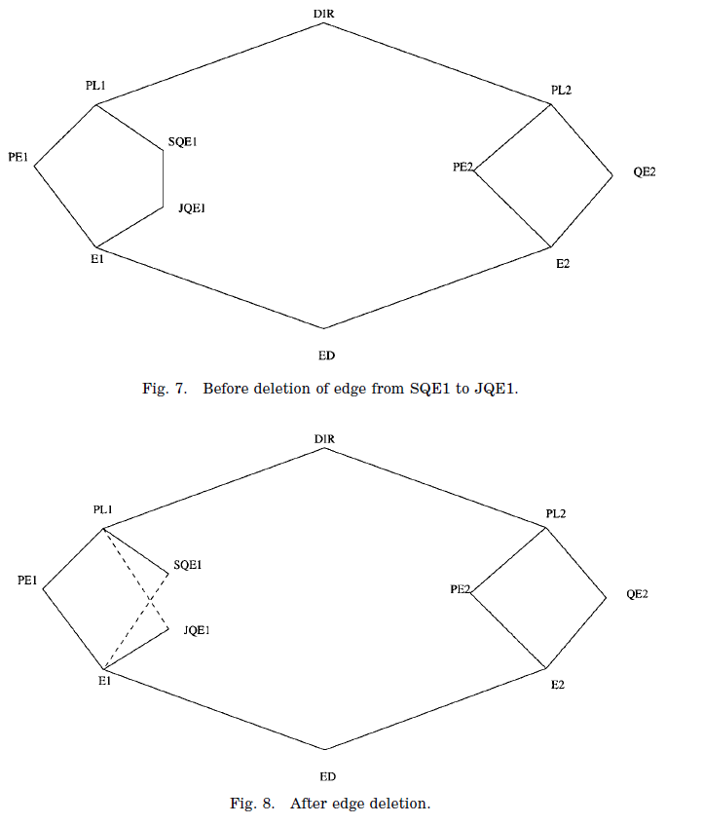
Example

Slide 66
Role Mining
One of the most critical and challenging tasks in implementing RBAC is the identification of a complete and correct set of roles.
There are two basic approaches towards role engineering: top-down and bottom-up.
Top Down Approach:
Under the top-down approach, roles are defined by carefully analyzing and decomposing business processes into smaller units in a functionally independent manner.
These functional units are then associated with permissions on information systems.

Slide 67
Role Mining
Often, this is a cooperative process where various authorities from different disciplines understand the semantics of business processes of one another and then incorporate them in the form of roles.
Since there are often dozens of business processes, tens of thousands of users and millions of authorizations, this is rather a difficult task.
In contrast, since organizations do not exist in a vacuum, the bottom-up approach utilizes the existing permission assignments to formulate roles.

Slide 68
Role Mining
Starting from the existing permissions before RBAC is implemented, the bottom-up approach aggregates these into roles.
It may also be advantageous to use a mixture of the top-down and the bottom-up approaches to conduct role engineering.
While the top-down model is likely to ignore the existing permissions, a bottom-up model may not consider business functions of an organization.

Slide 69
Role Mining
Assuming that we can represent the user permissions as a binary matrix.
Informally, we define the basic role mining problem as follows:
Given a m × n binary matrix A representing the user-permissions, decompose A into two matrices B and C, where B is a m × k matrix representing the user-role assignment and C is k ×n matrix representing the role-permission association, such that k is minimal.

Slide 70
Role Mining
For example, two extreme cases
1) Where each user is placed in a role by itself.
i.e., k = m, B = I, the identity matrix, and C = A.
2) Where each permission is placed in a role by itself.
i.e., k = n, B = A, and C = I, the identity matrix.
Both of these decompositions are accurate, but are not necessarily minimal.
An alternative decomposition, is to place all users in a single role (i.e., k = 1).

Slide 71
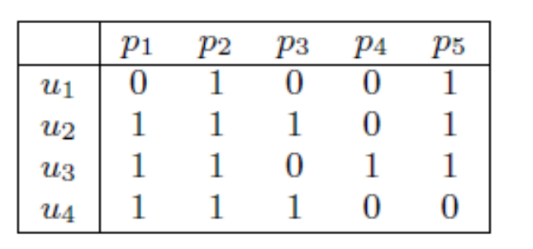
Role Mining
User-Permission Assignment

Slide 72
Role Mining
However, this decomposition is likely to be very inaccurate unless all of the users indeed have the same set of permissions.
In none of these cases are the roles likely to be accurate (i.e., close to reality).
What we are really interested in, is a fairly accurate set of
roles.
In this regard, we consider the minimal set of roles as the accurate set.
Minimality is a good notion, since it allows us to formally define the problem.

Slide 73
Role Mining
Without semantics (i.e., human expert knowledge), minimality serves as a best approximation for realizing good descriptive roles.
We formally define the basic RMP problem and show that the decision version is NP-complete by reducing the known NP-complete set basis problem to this.
We also consider several interesting variations of the basic RMP, including the δ-approx Role Mining Problem (δ- approx RMP) and the Minimal Noise Role Mining Problem (MinNoise RMP).

Slide 74
Role Mining
These are of practical importance. Both the δ-approx RMP and the MinNoise RMP are likely to result in a lower number of roles than the basic RMP – and might more accurately model the dynamic state of the organization.
Role Mining Problem:-
Given m users, n permissions and k roles (i.e., |U| = m, |PRMS| = n, |ROLES| = k), the user-to-role mapping can be represented as an m×k boolean matrix where a 1 in cell {ij} indicates the assignment of role j to user i.

Slide 75
Role Mining
Similarly, the role-to-permission mapping can be represented as an k × n boolean matrix where a 1 in cell {ij} indicates the assignment of permission j to role i.
Finally, the user-to permission mapping can be represented as an m×n Boolean matrix where a 1 in cell {ij} indicates the assignment of permission j to user i.

Slide 76
Role Mining
δ-Consistency:
A given user-to-role assignment UA, role-to-permission assignment PA and user to-permission assignment UPA are δ-consistent if and only if
|M(UA) ⊗M(PA) −M(UPA)|≤ δ
where M(UA), M(PA), and M(UPA) denote the matrix representation of UA, PA and UPA respectively.

Slide 77
RMP and its variants
Role Mining Problem (RMP):
Given a set of users U, a set of permissions PRMS, and a user permission assignment UPA, find a set of roles, a user-to-role assignment UA, and a role-to-permission assignment PA 0-consistent with UPA and minimizing the number of roles, k.
User-Permission Assignment

Slide 78
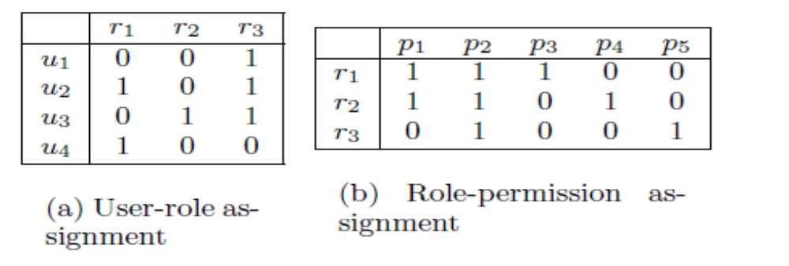
Example

Slide 79
RMP and its variants
δ-approx RMP:
Given a set of users U, a set of permissions PRMS, a user-permission assignment UPA, and a threshold δ, find a set of roles, a user-to-role assignment UA, and a role-to-permission assignment PA, δ-consistent with UPA and minimizing the number of roles, k.

Slide 80
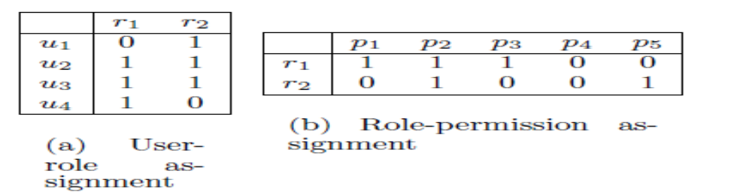

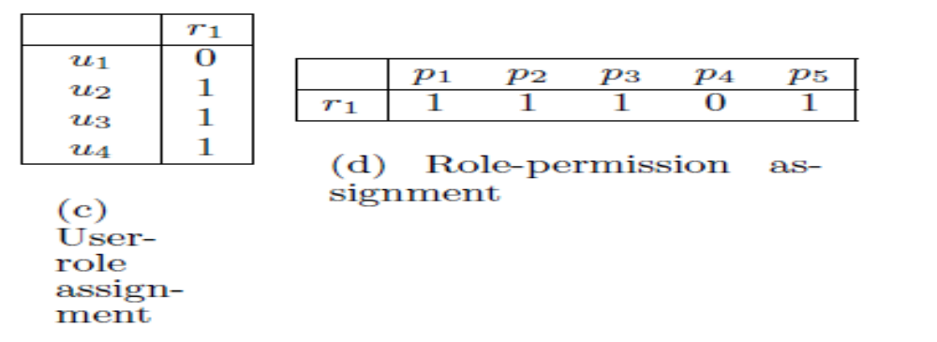
Example

Slide 81
RMP and its variants
Minimal Noise RMP:
Given a set of users U, a set of permissions PRMS, a user-permission assignment UPA, and the number of roles k, find a set of k roles, a user-to-role assignment UA, and a role-to-permission assignment PA, minimizing
|M(UA) ⊗M(PA) −M(UPA)|
where M(UA),M(PA), and M(UPA) denote the matrix representation of UA, PA and UPA respectively.

Slide 82
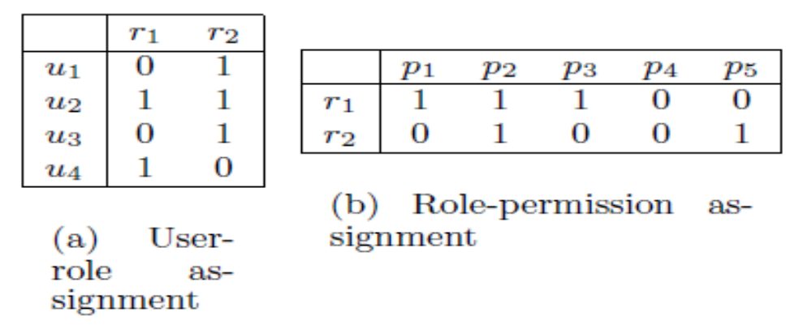
Example

Slide 83
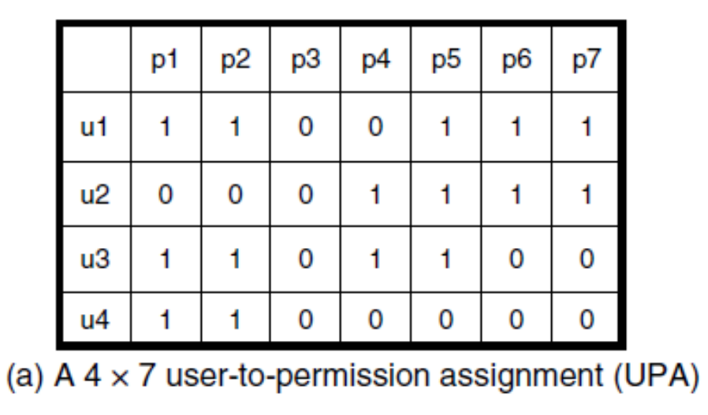
MAPPING THE RMP TO THE TILING
PROBLEM
Minimum Tiling:
Given a boolean matrix, find a tiling of the matrix with area equal to the total number of 1s in the matrix and consisting of the least possible number of tiles.

Slide 84
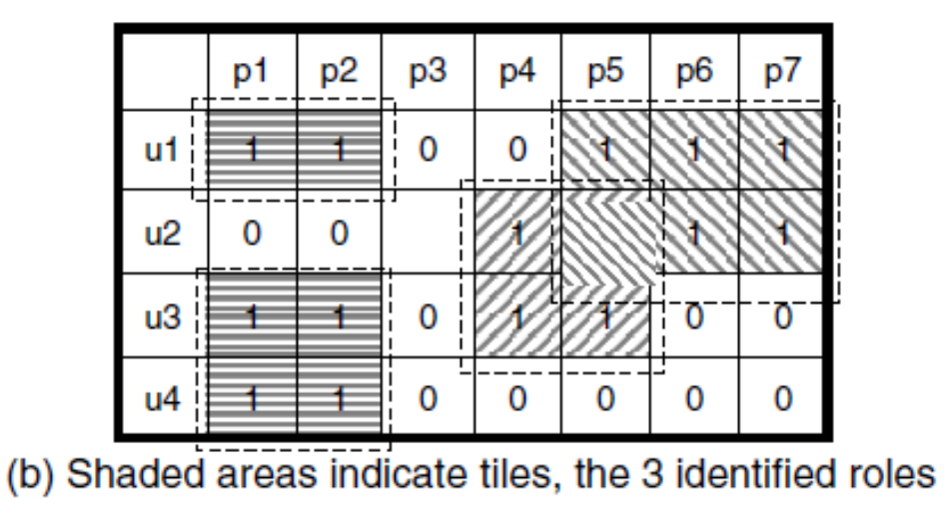
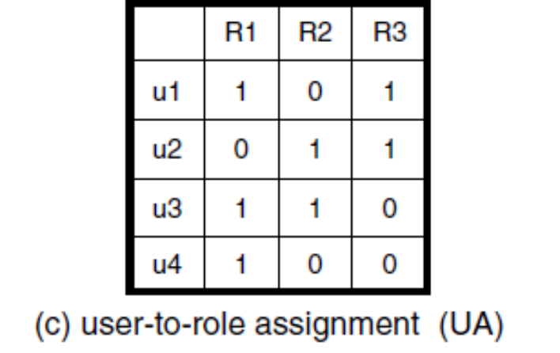
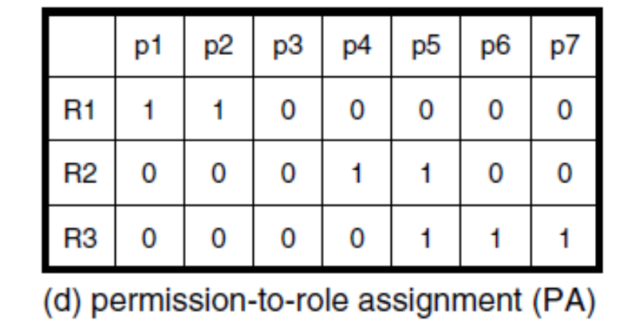
Example

Slide 85
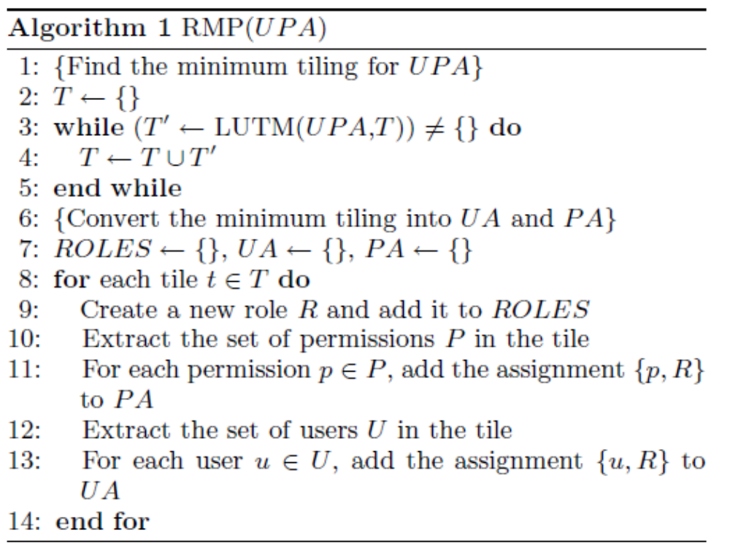
Algorithm
The LUTM algorithm is a depth-first recursive algorithm that finds the largest uncovered tile.

Slide 86
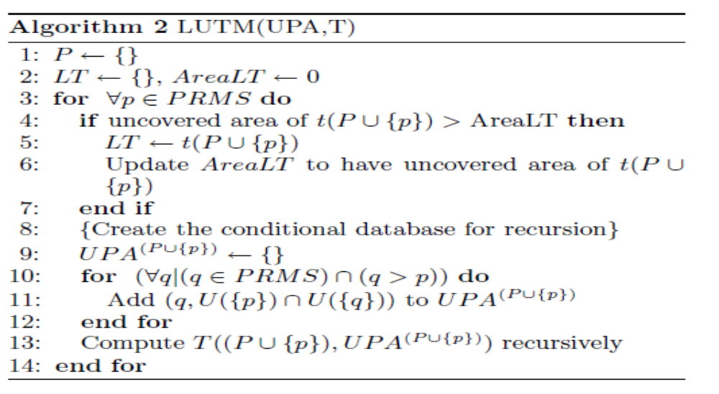
Algorithm

Slide 87
Example
Initial Execution
P ←{}, LT ←{}, AreaLT ← 0
For p1
Uncovered area of t(p1)= |p1|*|U(p1)| = 1 *3 = 3> AreaLT
LT ← t(p1)
AreaLT ← 3
UPA^{P} ^{∪{ p1}} {p2 (u1,u3,u4), p4(u3), p5(u1,u3), p6 (u1), p7(u1)}
T((p1), UPA^{p1})
T ← {(u1,p1),(u3,p1),(u4,p1)}
For p2
Uncovered area of t(p1∪ p2)= |p1∪ p2|*|U(p2)| = 2 *3 = 6> AreaLT
LT ← t(p1∪ p2)

Slide 88
Example
AreaLT ← 6
UPA^{p1∪{p2}} {p4(u3), p5(u1,u3), p6 (u1), p7(u1)}
T((p1), UPA^{p1∪{p2}})
T ← {(u1,p1),(u3,p1),(u4,p1), (u1,p2),(u3,p2),(u4,p2)}
For p4
Uncovered area of t({p1,p2}∪p4)= |p1∪p2∪p4|*|U(p4)|=3*1=3!> AreaLT
LT ← t({p1, p2}∪{})
AreaLT ← 6
UPA^{(p1,p2)∪{}} {}
T((p1,p2), UPA^{(p1,p2)∪{}})
T1 ← {(u1,p1),(u3,p1),(u4,p1), (u1,p2),(u3,p2),(u4,p2)}

Slide 89
Example
Initial Execution
P ←{}, LT ←{}, AreaLT ← 0
For p4
Uncovered area of t(p4)= |p4|*|U(p4)| = 1 *2 = 2> AreaLT
LT ← t(p4)
 | p4 | p5 | p6 | p7
u1 | 0 | 1 | 1 | 1
u2 | 1 | 1 | 1 | 1
u3 | 1 | 1 | 0 | 0
u4 | 0 | 0 | 0 | 0

Slide 90
Example
AreaLT ← 2
UPA^{P} ^{∪{ p4}} {p5(u2,u3), p6 (u2), p7(u2)}
T((p4), UPA^{p4})
T ← {(u2,p4),(u3,p4)}
For p5
Uncovered area of t(p4∪p5)= |p4∪p5|*|U(p5)| = 2 *2 = 4> AreaLT
LT ← t(p4∪p5)
AreaLT ← 4
UPA^{p4∪{ p5}} {p6 (u2), p7(u2)}
T((p4 ∪p5), UPA^{p4∪{p5}})
T ← {(u2,p4),(u3,p4),(u2,p5),(u3,p5)}

Slide 91
Eaxmple
For p6
Uncovered area of t({p4,p5}∪p6)= |p4∪p5∪p6|*|U(p6)| = 3*1 = 3!> AreaLT
LT ← t(p4∪p5)
AreaLT ← 4
UPA(^{p4,p5)∪{}} {}
T((p4∪p5), UPA(^{p4,p5)})
T2 ← {(u2,p4),(u3,p4),(u2,p5),(u3,p5)}

Slide 92
Example
Initial Execution
P ←{}, LT ←{}, AreaLT ← 0
For p5
Uncovered area of t(p5)= |p5|*|U(p5)| = 1 *1 = > AreaLT
LT ← t(p5)
 | p5 | p6 | p7
u1 | 1 | 1 | 1
u2 | 1 | 1 | 1
u3 | 0 | 0 | 0
u4 | 0 | 0 | 0

Slide 93
Example
AreaLT ← 1
UPA^{P} ^{∪{ p5}} {p6(u1,u2), p7 (u1,u2)}
T((p5), UPA^{p5})
T ← {(u1,p5),(u2,p5)}
For p6
Uncovered area of t(p5∪p6)= |p5∪p6|*|U(p6)| = 2 *2 = 4> AreaLT
LT ← t(p5∪p6)
AreaLT ← 4
UPA^{p5∪{ p6}} {p7(u1,u2)}
T((p5 ∪p6), UPA^{p5∪{p6}})
T ← {(u1,p5),(u2,p5), (u1,p6),(u2,p6)}

Slide 94
Example
For p7
Uncovered area of t({p5,p6}∪p7)= |p5∪p6∪p7|*|U(p7)| = 3*2 = 6> AreaLT
LT ← t(p5∪p6∪p7)
AreaLT ← 6
UPA(^{p5,p6)∪{p7}} {}
T((p5∪p6 ∪p7), UPA(^{p5,p6,p7)})
T3 ← {(u1,p5),(u2,p5), (u1,p6),(u2,p6), (u1,p7),(u2,p7)}

Slide 95
Roles, UA and PA
T1 ← {(u1,p1),(u3,p1),(u4,p1), (u1,p2),(u3,p2),(u4,p2)}, Covered Area=6
T2 ← {(u2,p4),(u3,p4),(u2,p5),(u3,p5)} , Covered Area=4
T3← {(u1,p5),(u2,p5), (u1,p6),(u2,p6), (u1,p7),(u2,p7)}, Covered Area=5
For each tile create a new role and add to ROLES (R)
R={r1,r2,r3}
Extract permission p∈P in the tile, add assignment {p,R} to PA
r1={p1,p2}, r2={p4,p5}, r3={p5,p6,p7}
 | p1 | p2 | p3 | p4 | p5 | p6 | p7
r1 | 1 | 1 | 0 | 0 | 0 | 0 | 0
r2 | 0 | 0 | 0 | 1 | 1 | 0 | 0
r3 | 0 | 0 | 0 | 0 | 1 | 1 | 1

Slide 96
Roles, UA and PA
UA:
Extract the set of users U in the tile , add u,R} to UA
The above decomposition is optimal in the sense that it is impossible to find only two roles such that UA and PA will be 0-consistent with UPA.
 | r1 | r2 | r3
u1 | 1 | 0 | 1
u2 | 0 | 1 | 1
u3 | 1 | 1 | 0
u4 | 1 | 0 | 0

Slide 97
Minimum Biclique Cover
Bipartite Graph:
It is a graph whose vertices can be divided into two disjoint and independent sets U & V, such that every edge connects a vertex in U to one in V.
Biclique Cover (Complete Bipartite subgraph):
It is a special kind of bipartite graph where every vertex of the first set is connected to every vertex of the second set.

Slide 98
TRBAC: A Temporal Role-Based Access Control Model
Roles may be available to users at certain time periods, and unavailable at others.
TRBAC, which is an extension of RBAC, supports periodic role enabling and disabling.
Enabling and disabling actions may be given a priority, which is used to solve conflicting actions.
Periodic time is represented as a pair ([begin, end], P)
  Where [begin, end] is a time interval denoting the lower and upper bounds that are imposed on instants in P.
  P is a periodic expression denoting an infinite set of periodic time instants.

Slide 99
TRBAC
The formalism for periodic expressions is based on the notion of calendars.
A calendar is a countable set of contiguous intervals, numbered by integers called index of the intervals.
A subcalendar relationship can be established between calendars.
C₁ ⊆ C₂, if each interval of C₂ is exactly covered by a finite number of intervals of C₁.

Slide 100
TRBAC
That is, if for each interval I of C₂ there exists a subset of the intervals of C₁ such that I is included in the interval resulting from their union.
Calendars can be combined to represent more general periodic expressions.

Slide 101

TRBAC
Definition: (Periodic Expression) Given calendars C_{d} , C₁, …, C_{n,} a periodic expression P is defined as
-- It separates the set of starting points of intervals from the specifications of the duration of each interval in terms of calendar C_{d}.
For example, all.Years + {3, 7}.Months 2.Months
It is assumed that a set of calendars containing the calendars Hours, Days, Weeks, Months, and Years.

Slide 102
TRBAC
The bounds begin and end constraining a periodic expression are denoted by a pair of date expression of the form mm/dd/yyyy.
TRBAC Syntax:
(Prios, ≤)
It is a totally ordered set of priorities.
It contains at least two distinct members and , such that, for all x ɛ Prios,
Roles and Prios induce the following classes of expression
(Event Expression, Role Status Expression)

Slide 103

TRBAC
Simple event expression have the form enable R or disable R, where R ɛ Roles.
Prioritized event expression have the from p:E, where p ɛ Prios and E is an event expression.
Role status expression have the form enabled R or –enabled R, where R ɛ Roles.
Conflicting Events: Two event expressions enable R and disable R’ are conflicting if R = R’: in symbol, we write:

Slide 104
TRBAC
Basic building blocks of Role Enabling Base are event expressions and role status expressions.
Role enabling base is a set of elements of the following kinds:
Periodic events of the form (I, P, p:E), where
(a) I is a time interval
(b) P is a periodic expression
(c) p:E is a prioritized even expression with p < T.
2. Role triggers of the form:

Slide 105
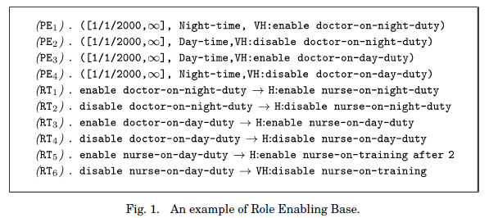
TRBAC

Slide 106

TRBAC
A run time request is always given top priority by default.
A run time request expression has the form
Priorities and delay expressions may be omitted. In that case, by default, p = T and .
Semantics:
Conflicting events can’t be solved by priorities.
Disabling-takes-precedence principle.

Slide 107
TRBAC
Definition: (Blocked Event, Non-blocked) Let S be a set of prioritized event expressions. We say that p:E ɛ S is blocked by S if there exists q ɛ Prios such that (q:conf(E)) ɛ S and either
E = enable R and p ≤ q, or
E = disable R and p < q.
The set of all members of S that are not blocked by S is denoted by Non-blocked(S).

Slide 108
TRBAC
Example:
Let S = { H:enable R0, H:disable R0, VH:enable R1, H:disable R1}
Nonblocked(S) = {H:disable R0, VH:enable R1}
Example:
Write a periodic expression to represent an infinite set of time intervals such that each interval begins at 9:00 am of every Monday, Tuesday and Wednesday of every week of the months of January, March, June and October of every year and lasts for 2 hours.
[∞, ∞], all.years + {1,3,6,10}.months + all.weeks + {1,2,3}.days + 9.hours 2. hours
Periodic Event:
[∞, ∞], all.years + {1,3,6,10}.months + all.weeks + {1,2,3}.days + 9.hours 2. hours, H:enable r1

Slide 109
Extension of RBAC
TRBAC
Roletemp ⊆ role × interval
ESTARBAC
Roleextents ⊆ role × location × interval
Permextents ⊆ permission × location × interval

Slide 110
ABAC
User to user attribute value assignment:
UUAV ⊆ U × UAV
Object to object attribute value assignment
OOAV ⊆ O × OAV
Policy
PUAV ⊆ P × UAV
POAV ⊆ P × OAV
PEAV ⊆ P × EAV
PR ⊆ P × R

Slide 111
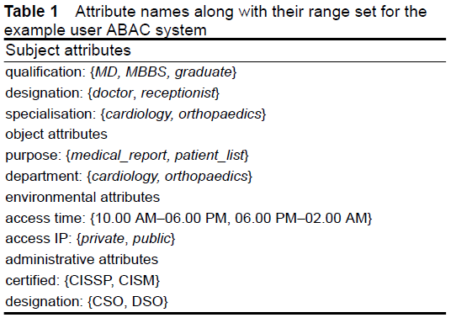
Example

Slide 112
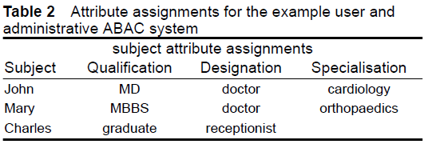
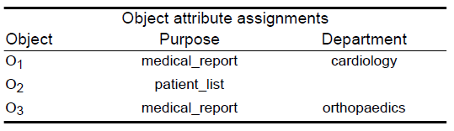
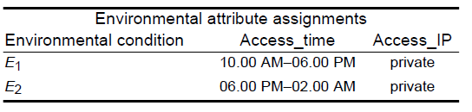
Cont..

Slide 113
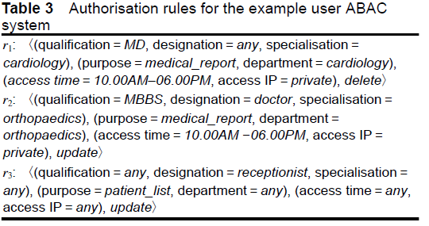
Cont..

